Slide 1

Objects
Inheritance
Chained Constructors
“virtual”

Slide 2
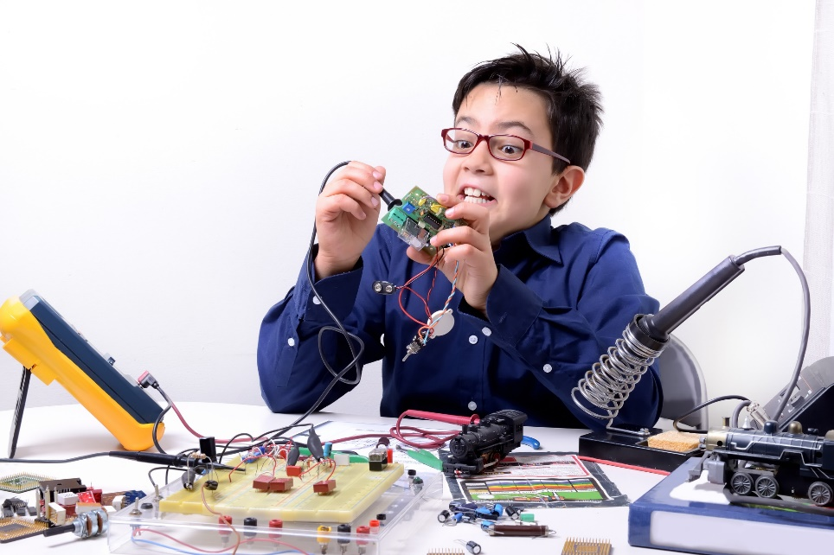
See Also
http://www.tutorialspoint.com/cplusplus/cpp_inheritance.htm
http://www.learncpp.com/cpp-tutorial/85-constructors/
http://stackoverflow.com/questions/2391679/why-do-we-need-virtual-methods-in-c

Slide 3
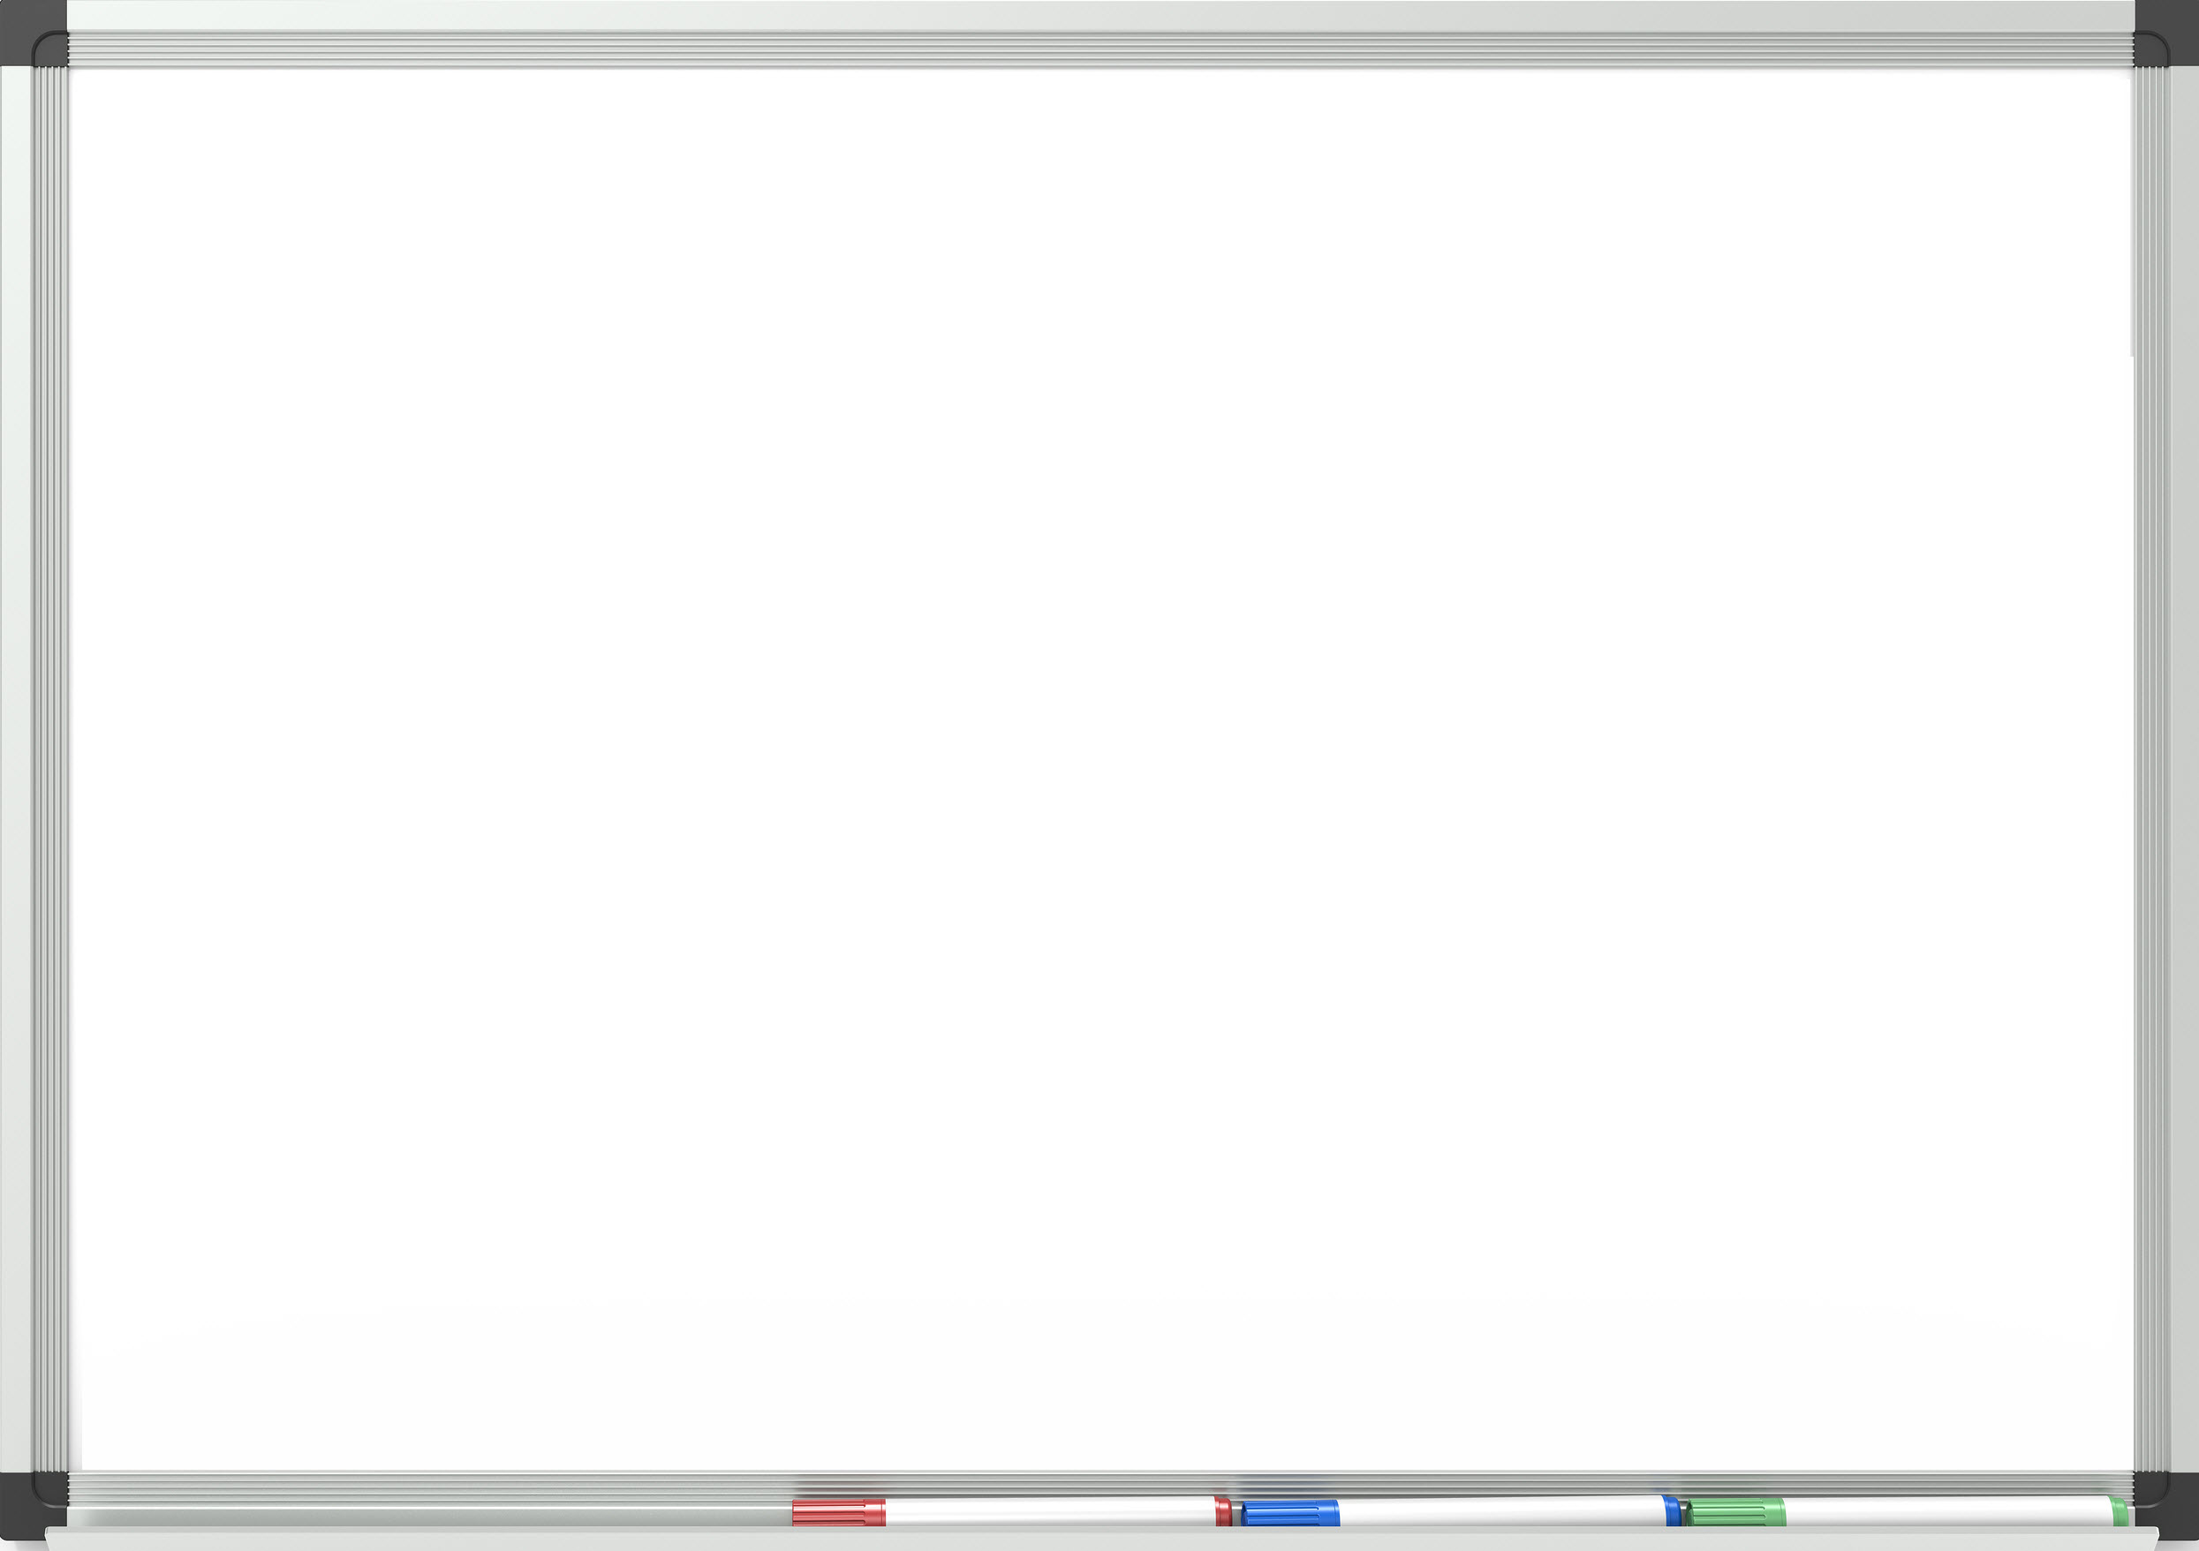
ColorPoint
class Point {
int x,y;
public:
Point(int x, int y) {
cout << "In constructor " << endl;
this->x = x;
this->y = y;
}
~Point() {
cout << "In destructor " << endl;
}
int getX() {
return x;
}
int getY() {
return y;
}
int sumCoords() {
return x + y;
}
};
class ColorPoint {
int color;
public:
ColorPoint(int x, int y, int color)
int getColor()
};
Point works
How to make a “ColorPoint”
Notes:
Point has been in the field for years.
@1 Now we need a “ColorPoint”.
It does everything that Point does, but it has an added “int” attribute of color.
@2 We need an added constructor that takes color
@3 And a getter for the color
Should we copy paste the code? Why or why not?

Slide 4
Inheriting
Start with an existing definition
Append to the end of it
class ColorPoint : public Point {
int color;
public:
int getColor() {
return color;
}
};
int main() {
ColorPoint *p = new ColorPoint(1,2,3);
cout << p->getX() << endl;
}
Notes:
You can start with an existing class and ADD TO IT. You can’t take anything away. If you inherit from something you get all its data members and methods.
@1 ColorPoint has a getX that it picks up from Point
We’ll see the constructor next

Slide 5
Chaining Constructors
You MUST call a base classes constructor first
The compiler will insert a call to the no-arg if you do not (what if the base class has no no-arg?)
class ColorPoint : public Point {
int color;
public:
ColorPoint(int x, int y, int color) : Point(x,y)
{
this->color = color;
}
int getColor() {
return color;
}
};
ColorPoint(int x, int y, int color) : Point()
Notes:
There is a new syntax. This is called an “Initializer list”. This tells the compiler to call the base class constructor BEFORE calling your constructor, and you pass any information you want.
If the baseclass has multiple constructors then you get to pick.
But you MUST call one of them. The compiler will try and be handy by sticking this in if you do nothing: @2
You’ll get a strange compile error if Point() doesn’t exist.

Slide 6
Long Chains
The base class constructor is called first in your constructor
The base class destructor is called LAST in your destructor
Compiler automatically calls destructor for you
You can extend the extended class all you want!

Slide 7


Is-a
void printCoords(Point * p) {
cout << p->getX() << " , " << p->getY() << endl;
}
int main() {
Point * p = new Point(1,2);
printCoords(p);
ColorPoint * q = new ColorPoint(4,5,100);
printCoords(q); // What the heck?
Point * r = new ColorPoint(6,7,8);
p = q;
q = r;
q = (ColorPoint)r;
}

Slide 8
Terminology
ColorPoint is-a Point. It can be used in place of.
ColorPoint extends Point. ColorPoint inherits from Point.
Point is the baseclass of ColorPoint
ColorPoint is a derived class from Point
If an object has a pointer to another object then we say it “has-a”. It uses another object, but doesn’t inherit from it.

Slide 9
Moving Point
class MovingPoint : public Point {
public:
MovingPoint(int x, int y) : Point(x,y) {}
int getX() {
x = x + 1;
return x;
}
int getY() {
y = y + 1;
return y;
}
};
class Point {
protected:
int x,y;
public:
int getX() {
return x;
}
Notes:
What happens if you give the same name to a method in a derived class? The “MovingPoint” has updated behavior.
How about a moving point that bumps the coordinates every time.
@1 We have trouble here. X and y are private in Point. Should we make them public? No. we are special because we are inheriting.
@2 Special permission “protected”.

Slide 10
Undesired Behavior?
void printMovCoords(MovingPoint * p) {
cout << p->getX() << " , " << p->getY() << endl;
}
void printCoords(Point * p) {
cout << p->getX() << " , " << p->getY() << endl;
}
int main() {
MovingPoint * p = new MovingPoint(1,2);
printMovCoords(p); // 2,3
printMovCoords(p); // 3,4
printMovCoords(p); // 4,5
printCoords(p); // ?
printCoords(p); // ?
}
Notes:
@1 Lets make a method to print the coordinates of a moving point
@2 Create one
@3 Call print … exactly what we wanted
But hold on a tick! We already had a function to print coords! Remember this? @4
@5 MovingPoint is a Point, right? What happens if we call it?
@6 Surprise!

Slide 11
Pick a Function
Point
x = 4
y = 5
int getX(Point * this) {
return x;
}
int getX(MovingPoint * this) {
x = x + 1;
return x;
}
MovingPoint
x = 4
y = 5
void printCoords(Point * p) {
cout << p->getX() << " , " << p->getY() << endl;
}
Notes:
Let’s create a Point and a MovingPoint and pass them to printCoords.
@1 Point
@2 MovingPoint
They look pretty much the same in memory. Hard to tell them apart!
@3 There are a couple of functions out there that take pointers to different kinds of objects.
Which one should the compiler call? All the compiler can do is say “p is a pointer to a point. I’ll call the plain Point version”

Slide 12
Pick a Function
getX()
int getX(Point * this) {
return x;
}
int getX(MovingPoint * this) {
x = x + 1;
return x;
}
Point
getY()
x = 4
y = 5
getX()
MovingPoint
getY()
x = 4
y = 5
void printCoords(Point * p) {
cout << p->getX() << " , " << p->getY() << endl;
}
Notes:
We want to add to the memory footprint and insert pointers to the desired functions. Now the compiler can follow the incoming pointer to the table and then follow that pointer to the correct function.
C programmers do this all the time. Functors.

Slide 13
Virtual Methods
class MovingPoint : public Point {
public:
MovingPoint(int x, int y) : Point(x,y) {}
int virtual getX() {
x = x + 1;
return x;
}
int virtual getY() {
y = y + 1;
return y;
}
};
class Point {
protected:
int x,y;
public:
int virtual getX() {
return x;
}
Notes:
C++ will do the functor work for you.
@1 You add the “virtual” keyword to the desired methods in the base class. The compiler will add that table to the memory footprint.
@2 Methods that you redefine in your derived class are automatically virtual whether you add the keyword or not. You should add it for your own sake.

Slide 14
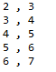
Polymorphism
void printCoords(Point * p) {
cout << p->getX() << " , " << p->getY() << endl;
}
int main() {
MovingPoint * p = new MovingPoint(1,2);
printMovCoords(p);
printMovCoords(p);
printMovCoords(p);
printCoords(p);
printCoords(p);
}
Notes:
Now we get the behavior we want @1
Notice the code in “printCoords” is divorced from a specific type of Point. It calls the point’s behavior indirectly through the virtual table.
This code will work with new kinds of points that have not even been written yet.
This code works with the API … it knows “getX” but doesn’t know exactly what that does.

Slide 15
Crystal Ball
Should you use all virtual methods? Languages like Java do.
There is an added cost to following the pointer.
There is an extra size in the memory footprint.
The wonderful Object Oriented design patterns depend on this polymorphism. See next class!

Slide 16
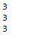
Another Bug
class Point {
virtual int sumCoords() {
return x + y;
}
};
int main() {
MovingPoint * p = new MovingPoint(1,2);
cout << p->sumCoords() << endl;
cout << p->sumCoords() << endl;
cout << p->sumCoords() << endl;
}
Notes:
What happens here? What do you want to happen?
@1 This is what happens
Is that what you want? I’m thinking that the act of summing the coordinates should check the coordinates and thus move the point. Where is the code to move the point? It is in the MovingPoint getters.

Slide 17
Another Bug
class Point {
protected:
int x,y;
public:
virtual int getX() {
return x;
}
virtual int getY() {
return y;
}
virtual int sumCoords() {
return getX() + getY();
}
};
class MovingPoint : public Point {
public:
virtual int getX() {
x = x + 1;
return x;
}
virtual int getY() {
y = y + 1;
return y;
}
};
Notes:
Now we change sumCoords to call the getters. We always hide behind a method. When we make Point this seems silly, doesn’t it?

Slide 18

Another Bug
class Point {
virtual int sumCoords() {
return getX() + getY();
}
};
int main() {
MovingPoint * p = new MovingPoint(1,2);
cout << p->sumCoords() << endl;
cout << p->sumCoords() << endl;
cout << p->sumCoords() << endl;
}

Slide 19

Your Turn
Complete the lab exercise!

